Slide 1
Position Tracking System
200X
Developed by the Programmers of 200X
(Braden Mah, Nick Short, Michael Sirna, Farees Siddiqui)

Slide 2
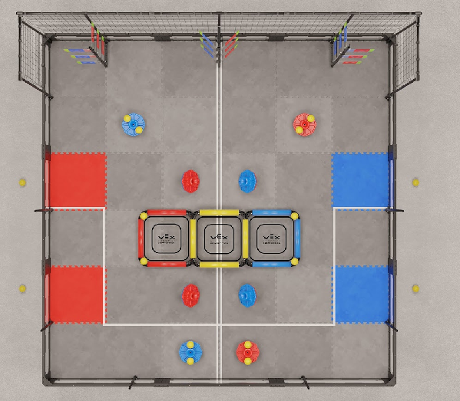
The Field and the Coordinate System

Slide 3
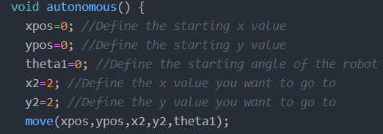
Getting Started

Slide 4
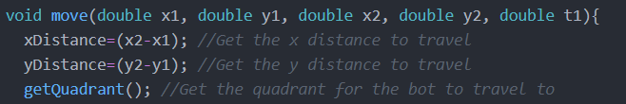
Finding the Distances

Slide 5
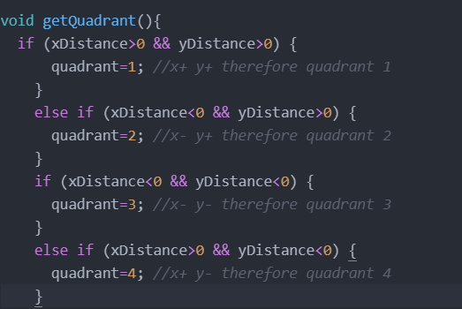
Finding the Quadrants
y
Q2
X-
Y+
Q1
X+
Y+
x
Q3
X-
Y-
Q4
X+
Y-

Slide 6
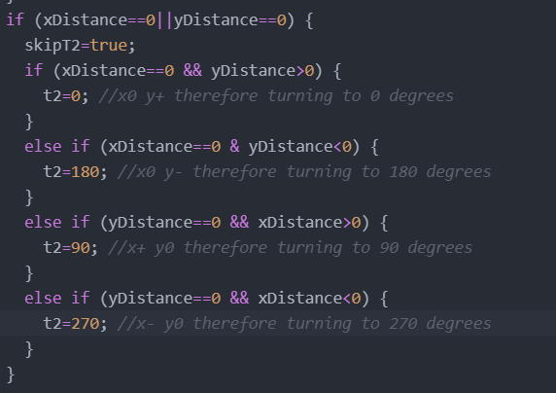
Finding Theta2 (Special Cases)

Slide 7
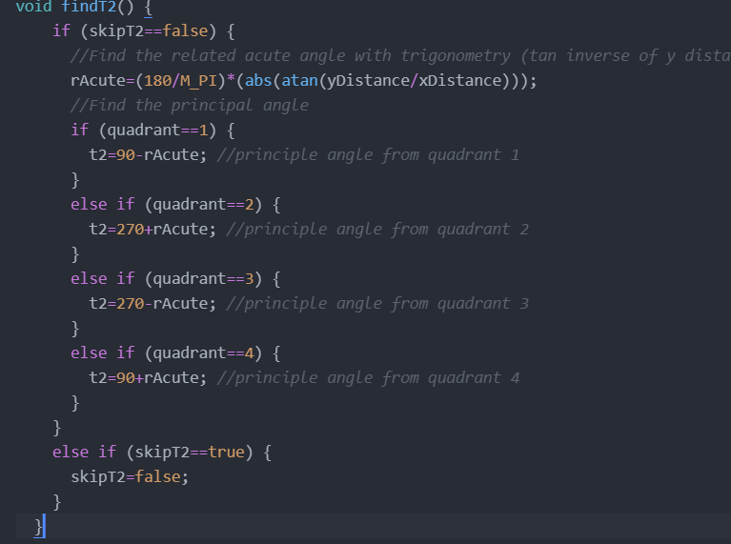
Finding Theta2
y
t2=90-45 =45°
2
rAcute=45°
x
2

Slide 8
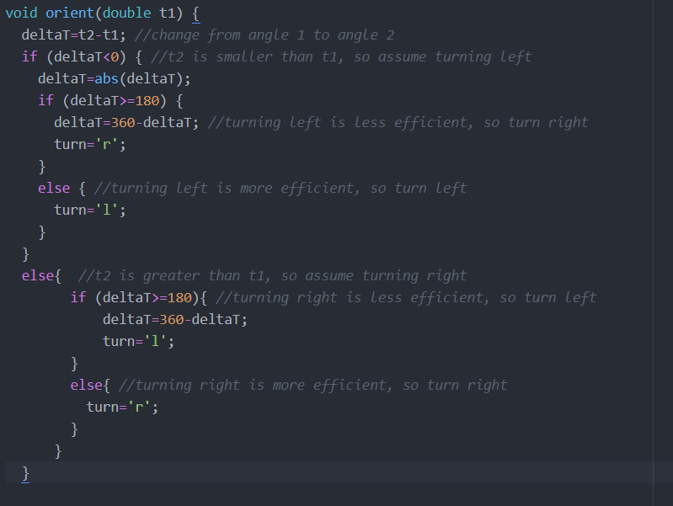
Finding Turn Direction and Change in Angle

Slide 9
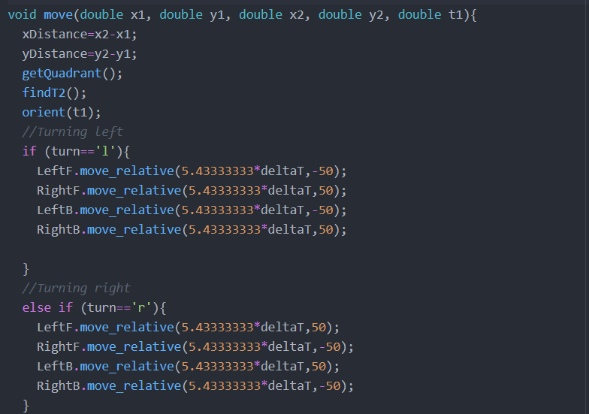
Turning!

Slide 10
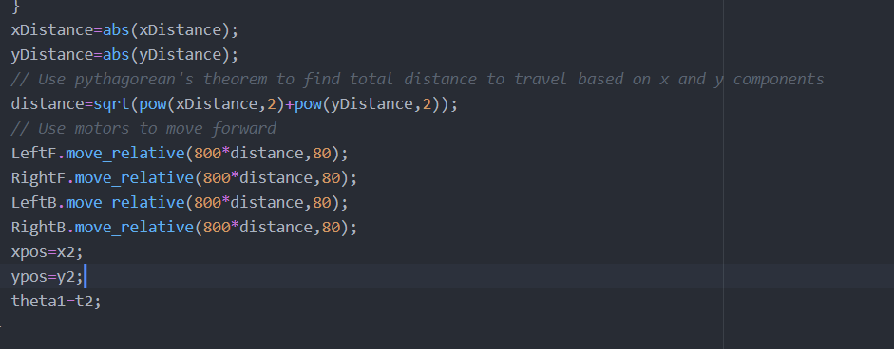
Moving!

